Slide 1
Tumors of pharynx
By
Dr. Mariwan latif fatah

Slide 2
Nasopharyngeal tumors
more common in Asia, Rare in the US
Chinese native > Chinese immigrant > North American native
High index of suspicion required for early diagnosis
Nasopharyngeal malignancies
SCC (nasopharyngeal carcinoma) 85%
Lymphoma
Salivary gland tumors
Sarcomas

Slide 3
EPIDEMIOLOGY
Environmental
Viruses
EBV- HPV
Nitrosamines - salted fish
Other recognized risk factors for NPC are cigarette smoking, and occupational exposure to formaldehyde and wood dust.

Slide 4
History:
Cervical LAP 60 %
Nasal obstruction 20%
CHD 20%
Cranial nerve palsies 10%

Slide 5
Clinical Presentation
Facial pain - Trigeminal n.
Diplopia - CN VI
Ophthalmoplegia - CN III, IV, and VI
Horner’s syndrome - cervical sympathetic
CN’s IX, X, XI, XII - extensive skull base

Slide 6
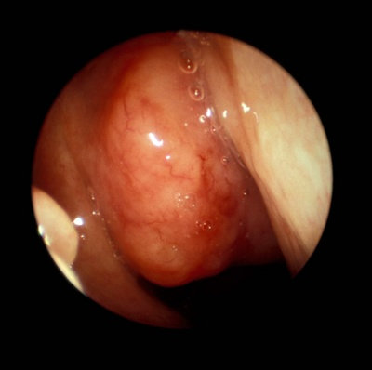
Examination
Postnasal mirror
Endoscopy

Slide 7
Nasopharyngeal examination
Fossa of Rosenmuller most common location
Variable appearance – exophytic , submucosal
NP may appear normal
Regional spread
Usually ipsilateral first but bilateral not uncommon
Distant spread - rare (<3%), lungs, liver, bones

Slide 8
Tests for Nasopharyngeal Cancer
Biopsy
Endoscopic biopsy
Fine needle aspiration (FNA) biopsy
Imaging tests
Chest x-ray
Computed tomography (CT) scan
Magnetic resonance imaging (MRI) scan
Positron emission tomography (PET) scan

Slide 9
Blood tests
Routine blood counts and blood chemistry tests
Epstein-Barr virus (EBV) DNA levels

Slide 10
Treatment
Radiochemotherapy
Neck dissection

Slide 11
Tumors of Oropharynx
The oropharynx is lined by squamous epithelium hence squamous cell carcinoma represents the most common tumour.
However there is abundant lymphoid tissue in the palatine tonsil as well as lingual tonsils, which gets involved with head and neck lymphomas.
Soft palate is especially rich in minor salivary glands.

Slide 12
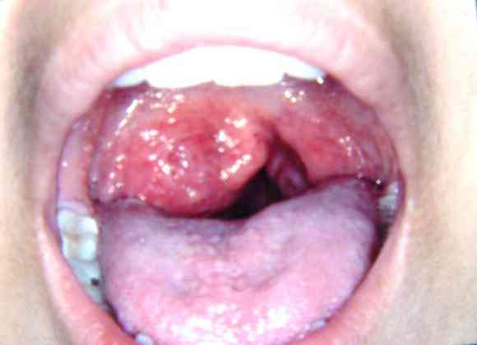
Squamous cell carcinoma
is most common malignancy and forms 90% of tumors of this region.
The most common sites involved are:
Lateral wall (60%)
Tongue base (25%)
Soft palate (10%)
Posterior wall (5%)

Slide 13
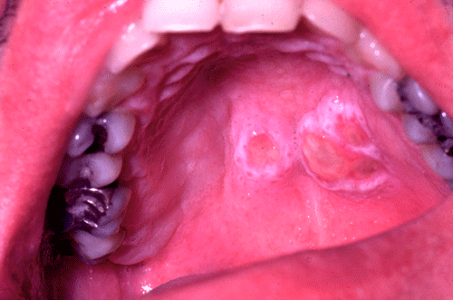
The minor salivary gland tumors have a predilection for soft palate.
In case of soft palate most minor salivary gland tumours are pleomorphic adenomas. Elsewhere malignant tumors are the rule and include adenoid-cystic and muco-epidermoid types.

Slide 14

Lymphomas
Lateral wall (tonsils) (90%)
Tongue base (10%)

Slide 15
Lateral wall tumors
Most common tumour (60%) and often involves tonsil.
Anteriorly spreads to retromolar trigone, buccal mucosa as well as muscles of tongue base. If the invasion gets deeper the pterygoid muscles are involved resulting in trismus.
Lateral spread involves angle of mandible.
Inferiorly the growth spreads to involve lateral pharyngeal wall and pyriform sinus. The aryepiglotic folds and para-glottic space are involved subsequently.
The lesions of the lower pole are often difficult to see and some times primary tumours can lurk with in tonsillar crypts as ‘occult primaries’

Slide 16
Clinical presentation
Symptoms frequently do not appear unless lesions are at an advanced stage.

Slide 17
Base of tongue tumors
60% to 70% of patients have positive palpable lymph nodes on presentation.
20% to 30% have bilateral lymph nodes..
20% of patients will present with neck nodes and no apparent primary.

Slide 18
The presenting features of oropharyngeal tumours
Sore throat
Otalgia
Dysphagia
Ulcers
Pain
Trismus
Neck masses
Majority of patients present late

Slide 19
Investigations
US of neck
CXR
CT/MRI is done to evaluate tongue base. To see the laterality of the lesion
It is important to assess any mandibular invasion (Orthopantogram)
CT scan of chest/abdomen

Slide 20
Biopsy
Panendoscopy ??? under GA is done to assess size, site and extent of primary tumor, to take a biopsy, to look for metastatic disease and synchronous lesions and to assess neck.
Incisional biopsy
If there is smooth regular involvement of tonsil then tonsillectomy
Deep biopsy for base of tongue

Slide 21
Treatment policy
Curative:
Radiotherapy
Surgery
Surgery plus post-operative radiotherapy
Palliative:
Radiotherapy
Radiotherapy and chemotherapy
Tracheostomy
Pain relief

Slide 22
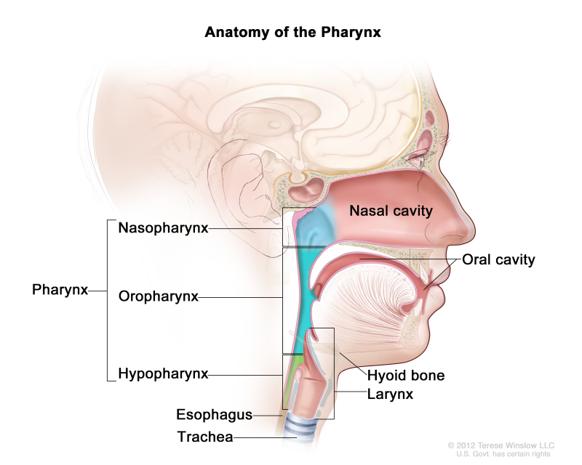
Hypopharynx Anatomical considerations
It is the lower most part of pharynx.
It begins at the level of tip of epiglottis and ends at lower border of cricoid cartilage

Slide 23
Tumours arising in this region often present in an advanced state
Key to cure lies in an early and accurate diagnosis, subsequent staging and in majority cases treatment by curative intent using surgery and post-operative radiotherapy.

Slide 24
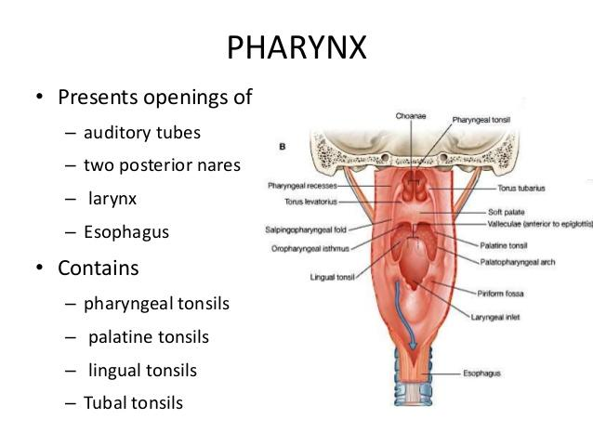
It consists of
Two piriform sinuses-one on each side
Posterior pharyngeal wall
Post-cricoid region where aerodigestive tract continues with cervical oesophagus

Slide 25
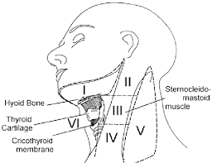
Lymphatics
Piriform sinus has a rich underlying network of lymphatics but this is less extensive in other subsites.
In general, the lymphatics in this area drain to deep cervical chain in level IV, but the inferior part of piriform sinus and post-cricoid area also drain to the paratracheal nodes in level VI, and the posterior pharyngeal wall also drains to the retropharyngeal lymph nodes

Slide 26
Surgical Pathology
Almost all carcinomas of the hypopharynx are squamous cell in type.
Tumours of the piriform sinus constitute the largest group of hypopharyngeal tumours.
Tumours of the post-cricoid space are the next most common hypopharyngeal.
Tumours on the posterior hypopharyngeal wall are the least common and constitute approx. 10% of these tumours
Alcohol and tobacco remain the two principal carcinogens implicated in tumours of the upper aerodigestive tract.

Slide 27
Post cricoid carcinoma
It remains the only squamous cell carcinoma more common in women than men.
In relation to post cricoid carcinoma a major dietary (iron deficiency) has particularly been described particularly with Plummer Vinson Syndrome.
This syndrome is also called Paterson Brown Kelly Syndrome

Slide 28
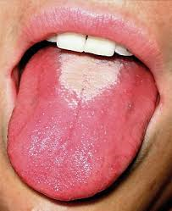
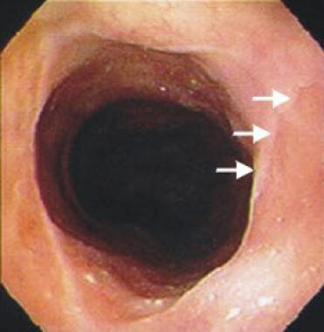
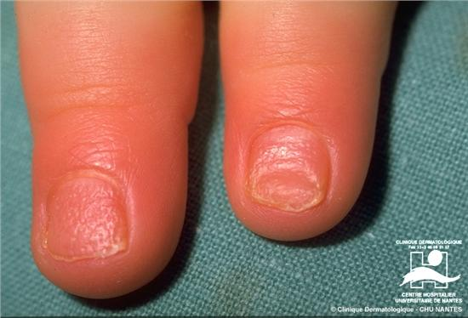
Paterson Brown Kelly Syndrome
Anaemia (both microcytic or macrocytic);
Glossitis
Oesophageal web
Spleenomegly
Koilonychia
Some patients also have history of irradiation of neck either external or internal as radio iodine for thyrotoxicosis.

Slide 29
Symptoms suggesting a possible pharyngeal tumours
Dysphagia: Often persistent and progressive. Patients who complain of food sticking in throat need to be investigated.
Pain: Usually lateralized and prominent on swallowing , may radiate to ipsilateral ear
Hoarseness: When it occurs in association with dysphagia or referred otalgia usually means extension of tumor into larynx

Slide 30
Symptoms suggesting a possible pharyngeal tumour
Neck Mass: Likely to be due to nodal metastasis, but may be due to direct extension through thyrohyoid membrane.
Hemoptysis: An unusual symptom, but can occur with tumors of Piriform Sinus or Post Pharyngeal wall.
Weight loss: Often occurs in presence of significant disease.

Slide 31
Examination
Indirect Laryngoscopy (IDL)
Direct Laryngoscopy (DL)

Slide 32
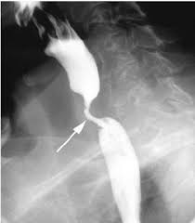
Radiological Assessment
Barium Swallow: Extremely useful investigation in these tumors. Objectives include:
To assess tumor length
To rule out synchronous primary tumor of esophagus
To ascertain presence or absence of aspiration
To assess tumor mobility on vertebral column

Slide 33
CT and MRI
To assess the extent of the primary tumor and extensions.
To rule out second primary and distant metastasis
To assess neck
To look for cartilage invasion

Slide 34
Endoscopy
Examination of oral cavity
Examination of larynx, pharynx, trachea and esophagus
Biopsy

Slide 35
Treatment policy
Approximately 25% of patients with hypopharyngeal carcinoma are not treatable at presentation due to advanced age, poor general health, inoperability of the tumor and extensive neck disease. Such patients may be considered for radiotherapy with a palliative intent. Chemotherapy has no established role.
Long term results may be obtained with surgery or radiotherapy but are not encouraging.
5 year survival rate with surgery and with or w/o post operative radiotherapy are 35%.

Slide 36


